Slide 1
Statistics – Then and Now
George Woodbury
CMC3 – December 2018

Slide 2

AB705
planet.ubuntu.com

Slide 3
New Ground for Many Instructors
Instructors who have never taught (or taken) statistics
Adjunct faculty

Slide 4
New Ground for Many Instructors
How to prepare?
  Work through a course as a student
  Sit in a colleague’s class
  Faculty bootcamps for professional development
  Assemble a collection of materials

Slide 5
New Ground for Many Instructors
Teaching statistics is different than teaching algebra
Focus on “how to teach” not just “what to teach”

Slide 6

In the Beginning …
business-through-adversity-kroselli.wikispaces.com

Slide 7

A Word of Encouragement
lorettasjourney.blogspot.com

Slide 8
A Word of Encouragement

Slide 9
A Word of Encouragement

Slide 10

Then
Formula Driven
Computations
www.justintarte.com

Slide 11

Now
Experimental Design
Interpretation of Results
learning.nd.edu

Slide 12

Engaging, Active Classroom
https://historytech.wordpress.com/2010/03/12/tip-of-the-week-interactive-lectures-i/

Slide 13
Active Learning Strategies
Flipped Classroom
Assessing to Learn – “Clicker” Questions, IF-AT
Class Activities and Projects

Slide 14

Role of Technology
http://tsaponar.blogspot.com/2013/05/my-students-prezi-presentation_8.html

Slide 15
Technology
Technology allows the shift from computation to interpretation
Technology can help students gain conceptual understanding of big picture ideas
Powerful, yet easy for students to use

Slide 16
Binomial Distribution

Slide 17
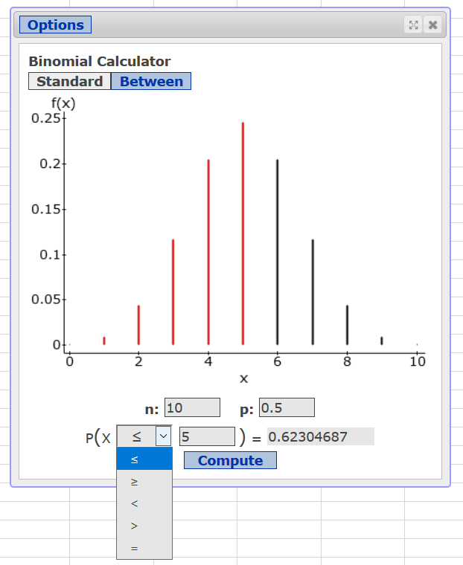
Binomial Distribution - Technology

Slide 18
Binomial Distribution – Then and Now
Less time working with the formula and the binomial tables
Less time trying to find the quickest/most efficient way to use the formula or tables to get the result
More problems and more interpretation
More time to connect to inference

Slide 19

What About Formulas?
smithlhhsb122.wikispaces.com/Nathan%20B.

Slide 20


Slide 21
My Inference Strategy
Being able to perform inference and understand the inferential work of others is my primary goal.
As often as possible, instruction/activities/projects should be aimed towards inference.

Slide 22
Inference: One Proportion
I tell my students that 50% of the students at our college are female.
Suppose we take a random sample of 50 students, and find that 30 of them are female.
Would it be unusual to have 30 or more females in a random sample of 50 students if 50% of all students are female?

Slide 23
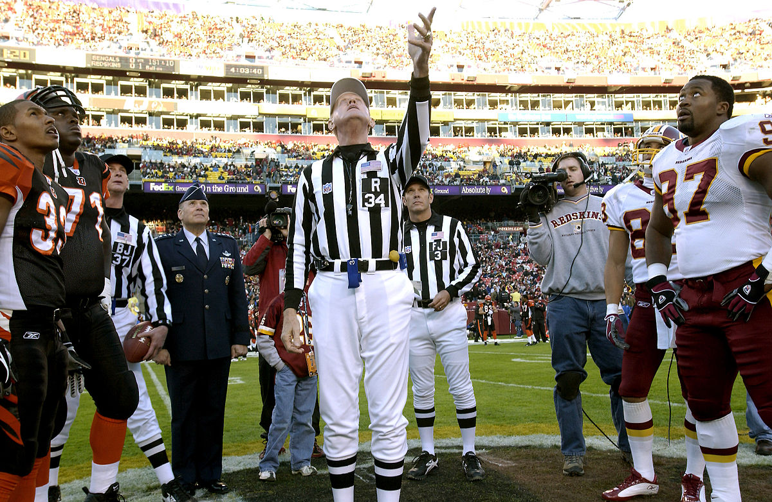
Investigation 1: Coin Flipping
wikipedia.org

Slide 24
Investigation 2: Binomial Distribution

Slide 25
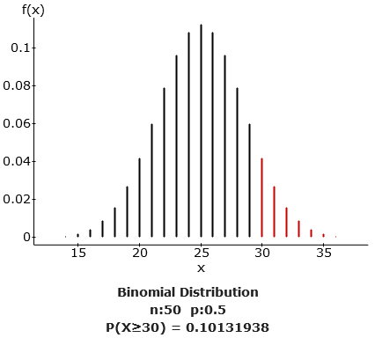

Slide 26
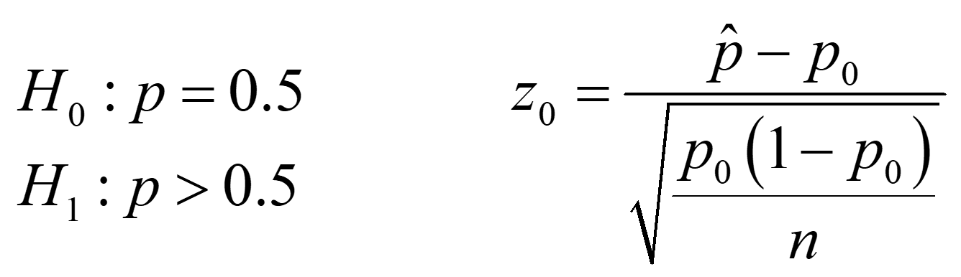
Investigation 3: One Proportion Test

Slide 27
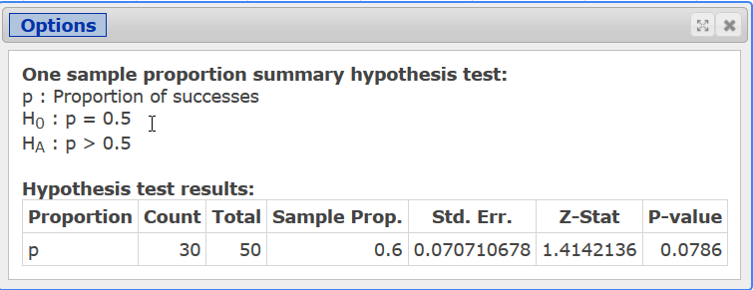
Investigation 3: One Proportion Test

Slide 28
Inference: One Mean
The mean wait time at a drive-thru of a fast food restaurant is 90 seconds. A new system is implemented to reduce the wait time.
Wait times (seconds) for 10 randomly selected customers:
109 67 58 76 65 80 96 86 71 72
Has the new system reduced the wait time?

Slide 29

Investigation 1: Bootstrapping
pixabay.com/fr/chaussure-de-randonn%C3%A9e-chaussures-25489/

Slide 30

Investigation 2: Sign Test
profslusos.blogspot.com/2014/03/comparacao-entre-proposta-de-alteracao_6681.html

Slide 31
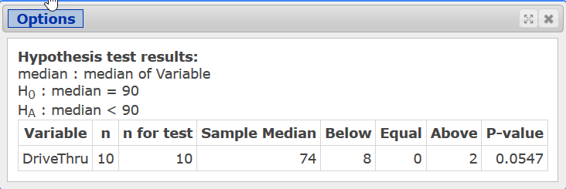
Investigation 2: Sign Test

Slide 32
Investigation 3: One Mean t-Test

Slide 33
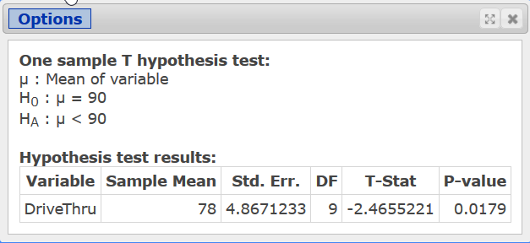
Investigation 3: One Mean t-Test

Slide 34
Inference: Two Means
Give students two sets of exam scores.
Ask them to determine whether the two versions of the exam are of equal difficulty.

Slide 35

Investigation 1: Descriptive Statistics
www.flickr.com/photos/jamesnaruke/1743713477

Slide 36

Investigation 2: Randomization
jcruz661.wikispaces.com/Dwire+February+Shapes

Slide 37
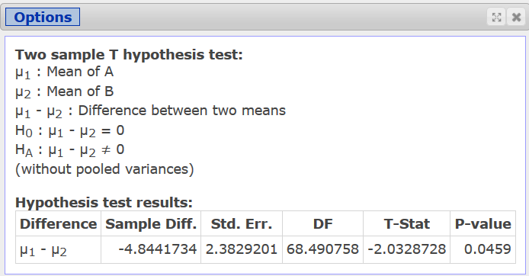
Investigation 3: Two Mean Test

Slide 38
Other Tests
Paired Difference Test
  Bootstrapping
  Wilcoxon Signed Ranks
Two Proportion Test
  Urn Sampling
  Randomization
ANOVA
  Kruskal Wallis

Slide 39

Crossroads
thewearypilgrim.typepad.com/the_weary_pilgrim/leadership/

Slide 40
Now
Focus on Setup and Design
Collecting Data
Interpreting Results
Keep an Eye on the Big Picture
“Just Enough” Probability
Active and Engaging
Leverage Technology to Increase Intuition and Understanding

Slide 41
Interactive Statistics (2e)
Helps support active learning by providing some direct instruction outside of class, allowing more time for in-class activities and projects.
Ideal for traditional classes, flipped classes, AND online classes.
Students work through Interactive Reading Assignments where students read a little, watch a little, and do a little.

Slide 42
Interactive Statistics (2e)
Contains several interactive applets to help students build conceptual understanding.
Nearly every example has 4 videos: by hand, TI-84, StatCrunch, Excel.
Built-in Integrated Review goes live in 8 weeks, in time for co-req support classes.

Slide 43
Interactive Statistics (2e)
Download MyLab course – search for Sullivan Woodbury
Our Course ID’s You Can Copy
  sullivan-pearson46507
  woodbury30422

Slide 44
Contact Info
Email: georgew@cos.edu
Twitter: @georgewoodbury
Website: georgewoodbury.com
Blogs:
  Statistics Blog: georgewoodbury.com/statblog/
  Math Blog: georgewoodbury.com/blogarithm/

